Slide 1
Trillence
Music, your way.
A SubPart project

Slide 2
WHAT IS TRILLENCE?
Trillence is a music streaming service designed for home servers, allowing users to stream their own music from any device, anywhere in the world.*
"We were searching for a discreet solution to stream music from a local music library to our devices for free, with the lightest impact on storage and we didn’t find exactly what we were looking for…
So, we created our own."

Slide 3
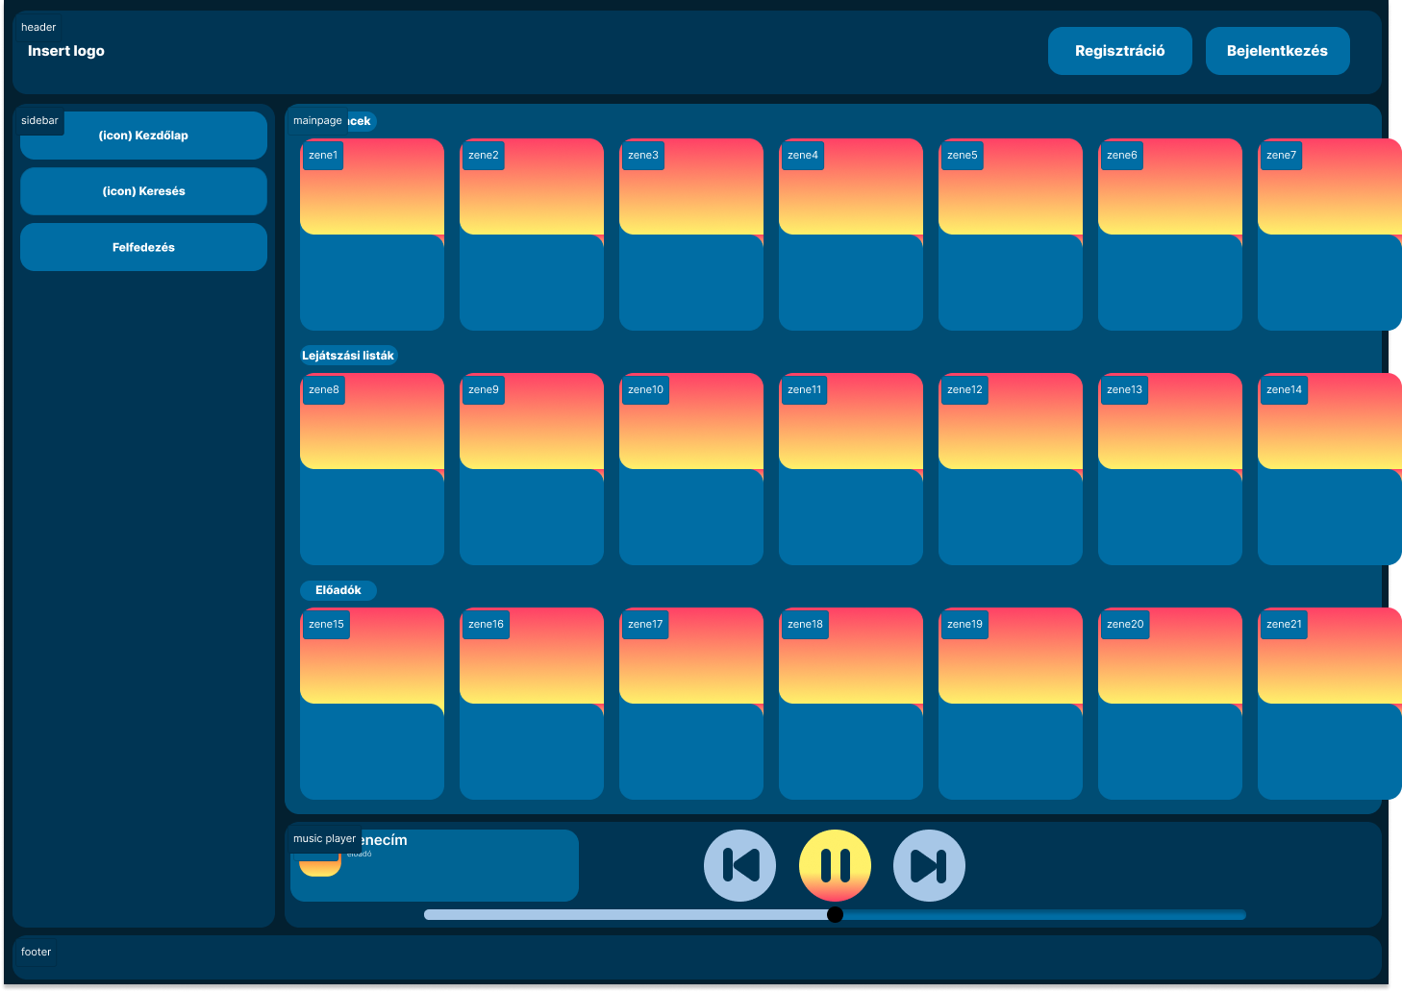
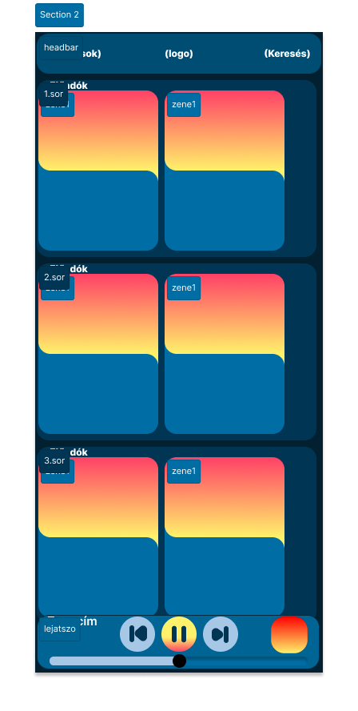
IT’S VERSATILE
Trillence scales according to your devices’ measurements
-
So you can take it anywhere you go!

Slide 4
IT’S DYNAMIC
Trillence uses Spotifys readily available selection of songs to collect information from using a program called spotDL
spotDL downloads the metadata from spotify songs and merges them onto already existing songs, or downloads them and adds them to your library

Slide 5
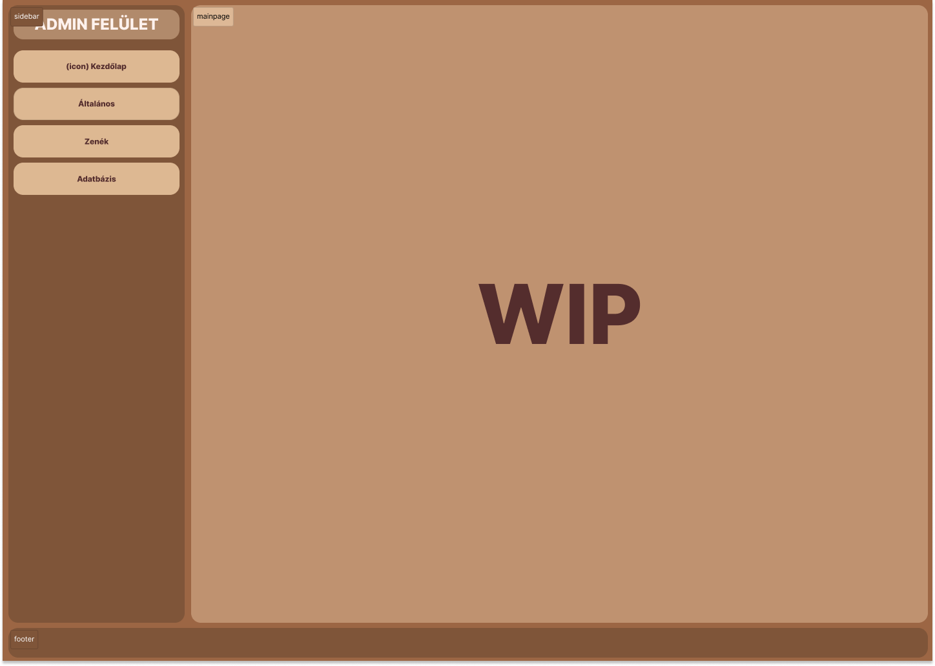
IT’S CONFIGURABLE
You can configure the Trillence app to your liking.
From the look of the app, to the individual songs.

Slide 6
THE DEVELOPERS
Bodnár István Gábor
Fekete László
Takács Krisztián
UI/UX Design and Planning
Frontend programming and documentation
Backend programming and documentation
Oversaw the design and experience planning of the user interface using the Figma design tool.
Responsible for the design and implementation of the application's frontend using the ReactJS framework.
Took on the development of the backend server using the ASP.NET framework and the creation of project documentation.

